Slide 1

Energy Efficient clustering protocol of wireless sensor networks using Biogeography-based Optimization
Mr. Raju Pal
(Assistant Professor)
raju.pal@jiit.ac.in, Mob.No.: 7840045107
Jaypee Institute of Information Technology, Noida

Slide 2
Wireless sensor Network
Sensor networks have recently emerged as an important computing platform.
Sensor Nodes are usually:
Typically less mobile and more densely
deployed than mobile ad-hoc networks
(MANETs).
Limited in processing, memory, and
communication capabilities
Constrained in battery lifetime
Left unattended e.g., in hostile
environments, which makes it difficult
impossible to re-charge or replace their batteries.

Slide 3

Sensor Networks Overview
Application - Specific, e.g.,
Monitoring physical or environmental conditions, such as temperature, sound, vibration, pressure, motion or pollutants.
Surveying military fields
Reporting radiation levels at nuclear plants
Used in many civilian application areas, including environment and habitat monitoring, healthcare applications, fire detection

Slide 4

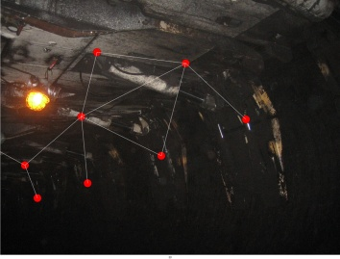

Wireless Sensor Networks
sensed data
Coal Mine Safety
Digital
World
sensed data
Water Resource Management
sensed data
sensed data
sensed data
sensed data
Physical World
World Expo Surveillance

Slide 5
What is the problem?
Designed around acceptable E_{b}/N₀
E_{elec} = 50nJ/bit
Energy dissipation for transmit and receive
ε_{amp} = 100pJ/bit/m²
Energy dissipation for transmit amplifier
k = Packet size
d = Distance
Smaller distances ➔ less consumed energy

Slide 6

Solution
Have more hops to base station
Have more hops to base station
Clustering
Sensor nodes
Clusters
Cluster heads
Base station
End user
Sensor nodes
Cluster Head
Data sent by sensor nodes
Data sent by cluster heads

Slide 7
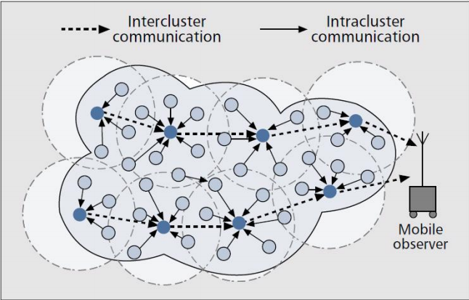
Clustering in WSN

Slide 8
Clustering using BBO
Sensor network is hierarchically clustered.
It contains two phases, similar to LEACH
Cluster set-up phase
Steady-state phase

Slide 9
Cluster set-up phase
Sensor nodes are grouped into various clusters
The quality of clustering has a high impact on the energy consumption of the sensor network.
To find a optimal set of cluster heads from the given number of n sensor nodes can be mapped as a combinatorial problem (NP-complete)
Various meta-heuristic methods are used to solve these problems.

Slide 10
BBO based clustering method for single round
Deploy the sensor nodes.
Initialize evolutionary algorithm.
Choose an initial population randomly;
Evaluate minimum fitness of each solution;
While termination criteria is not achieved do
Perform migration
Perform mutation
Evaluate fitness of the offspring;
End
Use the optimal set of cluster heads for WSN clustering
While the network is alive do
Evaluate the minimum distance from CH to sensor nodes.
Evaluate energy dissipated to transmit packet from node to CH.
Evaluate energy dissipated to receive packet from node.
End
Evaluate the remaining energy of the network.

Slide 11
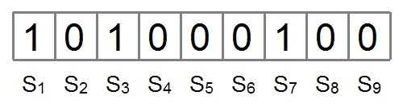
Population Initialization
Binary encoding scheme is used
The size of the Island is equal to the number of sensor nodes
Island representation for WSN having 9 sensor nodes

Slide 12

Fitness Function (HSI)
Measure the quality of Islands
For better clustering, the compactness between each cluster should be minimized and separation between the cluster heads should be maximized
For example,

Slide 13
Performance matrices
The performance is compared on five matrices:
Network Lifetime
Stability Period
Network Remaining Energy
Number of Alive nodes per round
Data packets received at base station

Slide 14
Number of alive nodes per round

Slide 15
Remaining energy of the network per round (in Joules)

Slide 16
The box-plot graphs for (a) Advanced CH nodes, and (b) The number of packtes sent to BS
(a)
(b)

Slide 17
References
Simon, Dan, Mahamed GH Omran, and Maurice Clerc. "Linearized biogeography-based optimization with re-initialization and local search." Information Sciences 267, 2014.
Ma, Haiping, et al. "Variations of biogeography-based optimization and Markov analysis." Information Sciences 220, 2013.
Z. M. Zahedi, R. Akbari, M. Shokouhifar, F. Safaei, and A. Jalali, “Swarm intelligence based fuzzy routing protocol for clustered wireless sensor networks,” Expert Systems with Applications, vol. 55, pp. 313–328, 2016.
D. Simon, “Biogeography-based optimization," IEEE Transactions on Evolutionary Computation, vol. 12, no. 6, pp. 702-713, December 2008.
R. MacArthur and E. Wilson, “The Theory of Biogeography”, Princeton, NJ: Princeton Univ. Press, 1967.
A. A. Baraa and E. A. Khalil, “A new evolutionary based routing protocol for clustered heterogeneous wireless sensor networks,” Applied Soft Computing, vol. 12, pp. 1950–1957, 2012.
A. W. Matin and S. Hussain, “Intelligent hierarchical cluster-based routing,” life, vol. 7, p. 8, 2006.
S. Hussain and A. W. Matin, “Energy efficient hierarchical cluster-based routing for wireless sensor networks,” Jodrey School of Computer Science Acadia University Wolfville, Nova Scotia, Canada, Technical Report, 2005.
G. Smaragdakis, I. Matta, A. Bestavros et al. “Sep: A stable election protocol for clustered heterogeneous wireless sensor networks,” in Second international workshop on sensor and actor network protocols and applications (SANPA 2004), vol. 3, 2004.

